Slide 1

Image Translator
Andy Liu
Dakota Williams
Yiming Sun
Yucheng Ma
此照片，作者: 未知作者，许可证: CC BY

Slide 2
Project Intro
We hope that this will make it easier for tourists and students to communicate and take notes. Sometimes professors talk/write too fast, and the only option left for these students is to take pictures. This is where our program will come in .

Slide 3
Yucheng and Yiming are international students. They can fluently communicate with everyone in English. But in the classroom, they are still struggling in many professional vocabulary. That's why we have this idea about our project.

Slide 4
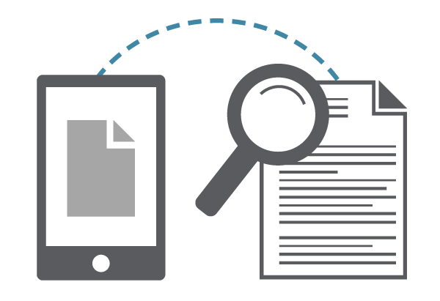
OCR Technology
Optical character recognition or optical character reader, often abbreviated as OCR, is the mechanical or electronic conversion of images of typed, handwritten or printed text into machine-encoded text, whether from a scanned document, a photo of a document, a scene-photo (for example the text on signs and billboards in a landscape photo) or from subtitle text superimposed on an image (for example from a television broadcast)。
——Wikipedia

Slide 5
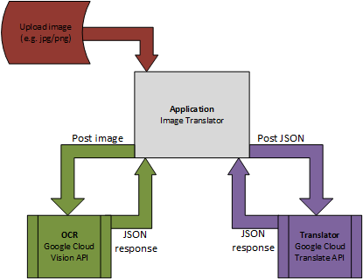
Initial Design

Slide 6
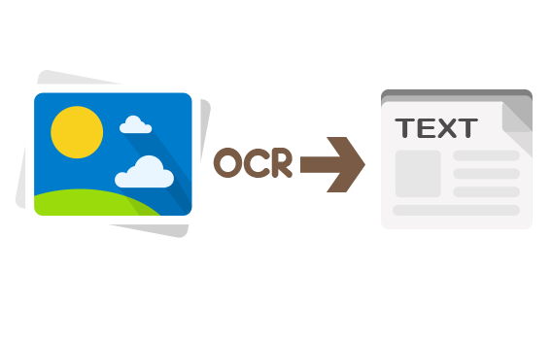

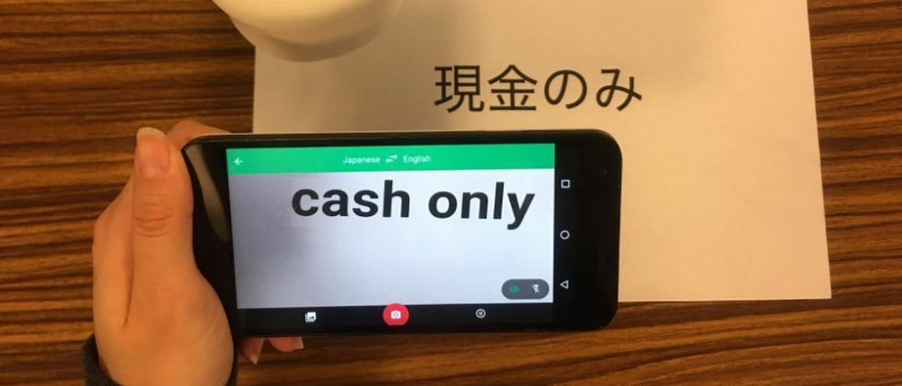
Our Image translator
Change the image words to text
Translate
Translated words

Slide 7
Main Tools
Vision API
Translate API
PyQt4

